Slide 1
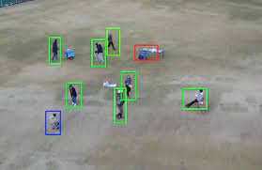
Person Detection in Aerial Images
Deep Learning Project - Final Presentation
Student Name: Pranav Deep. I
Course Instructor: Dr. Shiv Ram Dubey

Slide 2
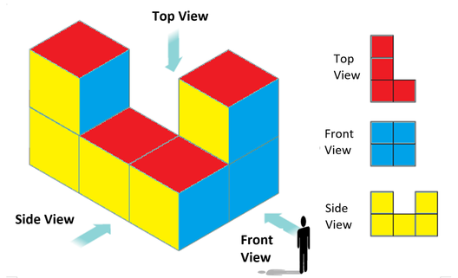
What are Aerial Images?
The term aerial imagery refers to all imagery taken from an airborne craft which can include drones, balloons or airplanes.
In traditional photography, we get the FRONT VIEW of the object while in aerial imagery, we get the TOP VIEW of the object

Slide 3
Motivation
India ranks 89th in disaster management according to World Risk Index (WRI) 2020, even lower than Sri Lanka, Bhutan & Maldives.
Search and Rescue Missions (SAR) missions in India is generally limited to Coast Guard or military operations only. (ISRO’s intervention in SAR missions has been a very recent trend, but mostly in case of high profile military operations like Indo-China border rescue missions etc.)
Local bodies(say Municipality) which has more statistics and information about the region has very limited resources and/or access to execute SAR missions during calamities or otherwise.
But all is not gloomy, as the procurement & setup cost of UAVs has significantly decreased.
However, automation in this domain is more/less not explored(Indian context).
To start with, I want to detect persons in aerial images in imagery that has been captured during calamity like scenario.

Slide 4
Challenges
There are many challenging aspects of aerial images:
Huge Image size (4000 * 3000), making it complex to load
Improper alignment of Label and Train images (Some images were missing in labels, some were missing in testing, improper naming, Length of characters of same set of images were different
Too many Shadows, object intersection, mirages etc.
Needed a lot of data preparation time

Slide 5
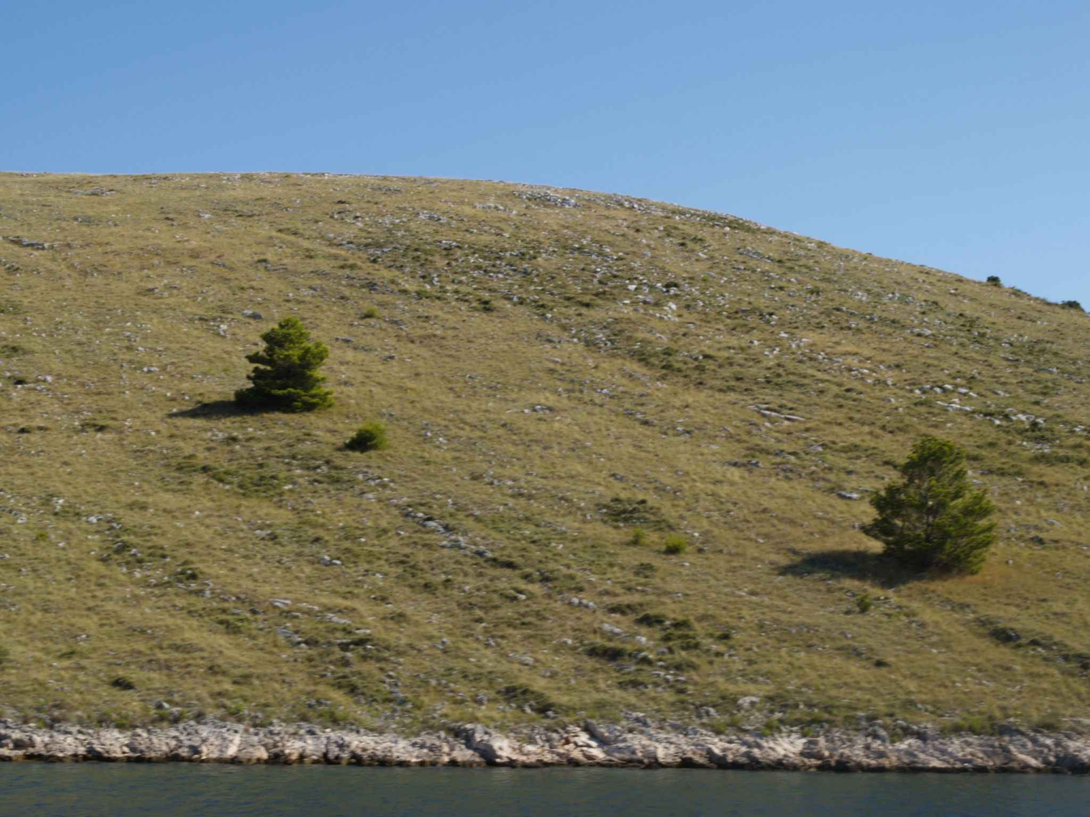
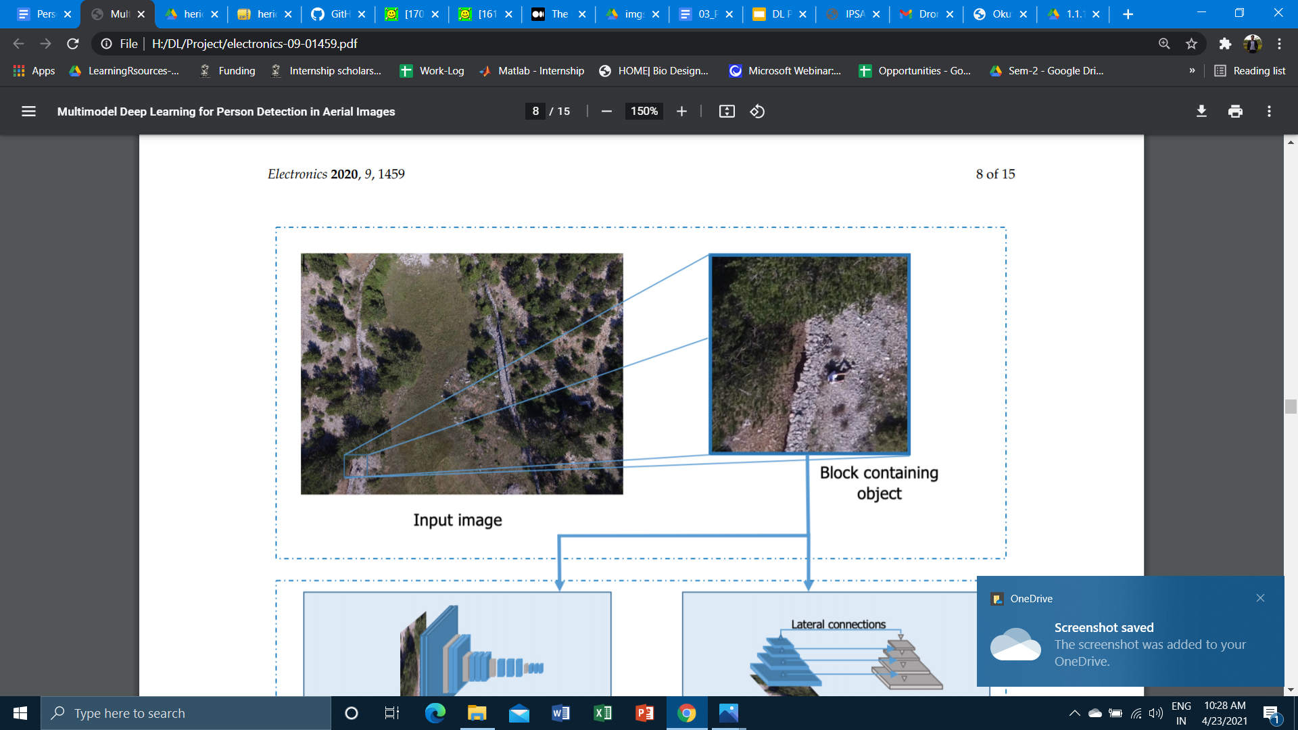
Heridal Dataset_{[5]}

Slide 6






Positive and Negative Samples
Image Size : 81 * 81
Channels : 3
+ve Images : ~29,000
-ve Images : ~32,000
Images are taken with a high resolution camera on the DJI Phantom 3, vertically at a 50 m altitude with the selected
Bigger Image Size : 3000*4000 (Used for feature matching)
+1
0
+1
Heridal Dataset
+1
0
+1
Source

Slide 7
My Experiments
Data Preprocessing (Cropping, Resizing, Matching Labels and Images etc, Dataset preparation according to each model)
Classification (using Patch Data) a) Machine Learning - SVM b) Deep Learning - Custom Network
Detection a) YOLO v5

Slide 8
SUPPORT VECTOR MACHINE
Linear Kernel [4]
Radial Basis Function Kernel [5]
Polynomial Kernel [5]
Performed Classification
Machine Learning Techniques
Experiments done with the aside mentioned methods

Slide 9
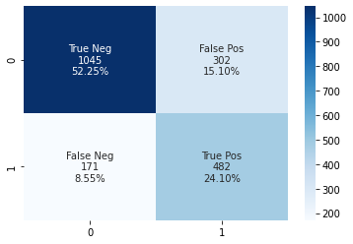
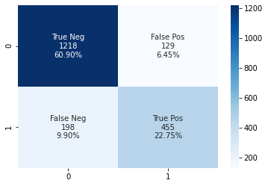
Confusion Matrices
Linear SVM
Polynomial SVM

Slide 10
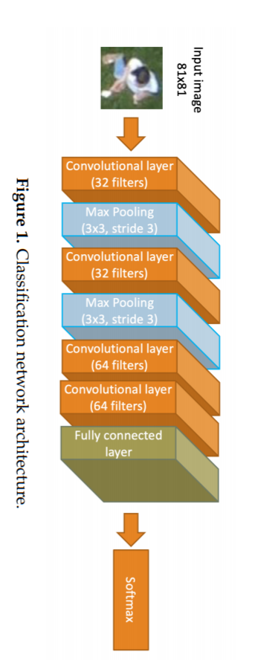
Model Architecture
Deep Learning Classifier
Changed final Activation fn. To sigmoid instead of softmax
Trainable params: 522,561
Epochs = 20
Batch Size = 32
Loss Fn. = Binary Cross Entropy
Optimizer = Adam
Used Dropout Layer - 0.5
Source [6]

Slide 11
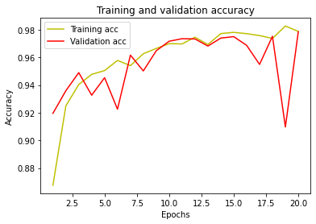
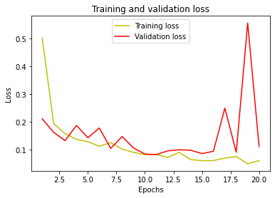
DL Model’s Accuracy and Loss plots

Slide 12
Results
Linear SVM
Polynomial SVM
DL Classifier
Training Accuracy | 100% | 96.7 % | 98.769 %
Validation Accuracy | NA | NA | 98.86 %
Testing Accuracy | 76.35 % | 83.65 % | 98.7611 %
Precision | 61.5 % | 77.9 % | 98.68 %
Recall | 73.8% | 69.7 % | 97.36 %

Slide 13
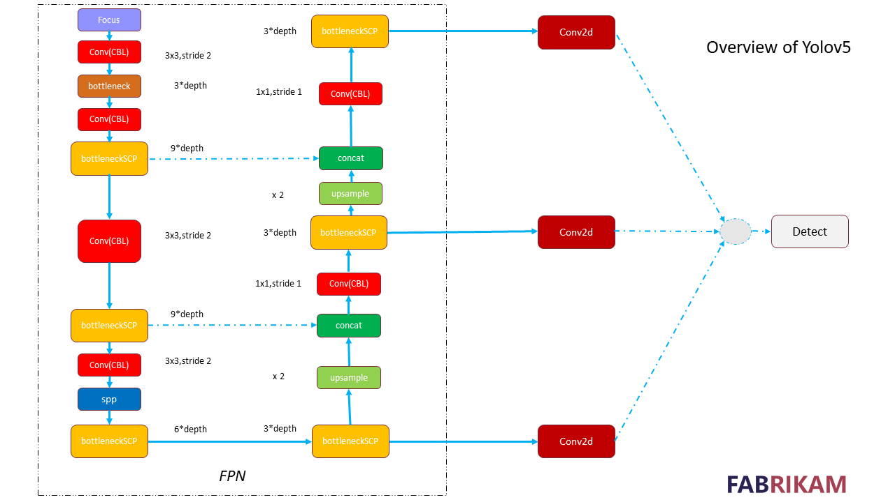

Slide 14
Hyperparameters
Learning Rate | 0.01
No. of Epochs | 200
Batch_Size | 16
Optimizer | SGD (+Momentum)
Momentum | 0.937
Weight Decay | 0.0005

Slide 15
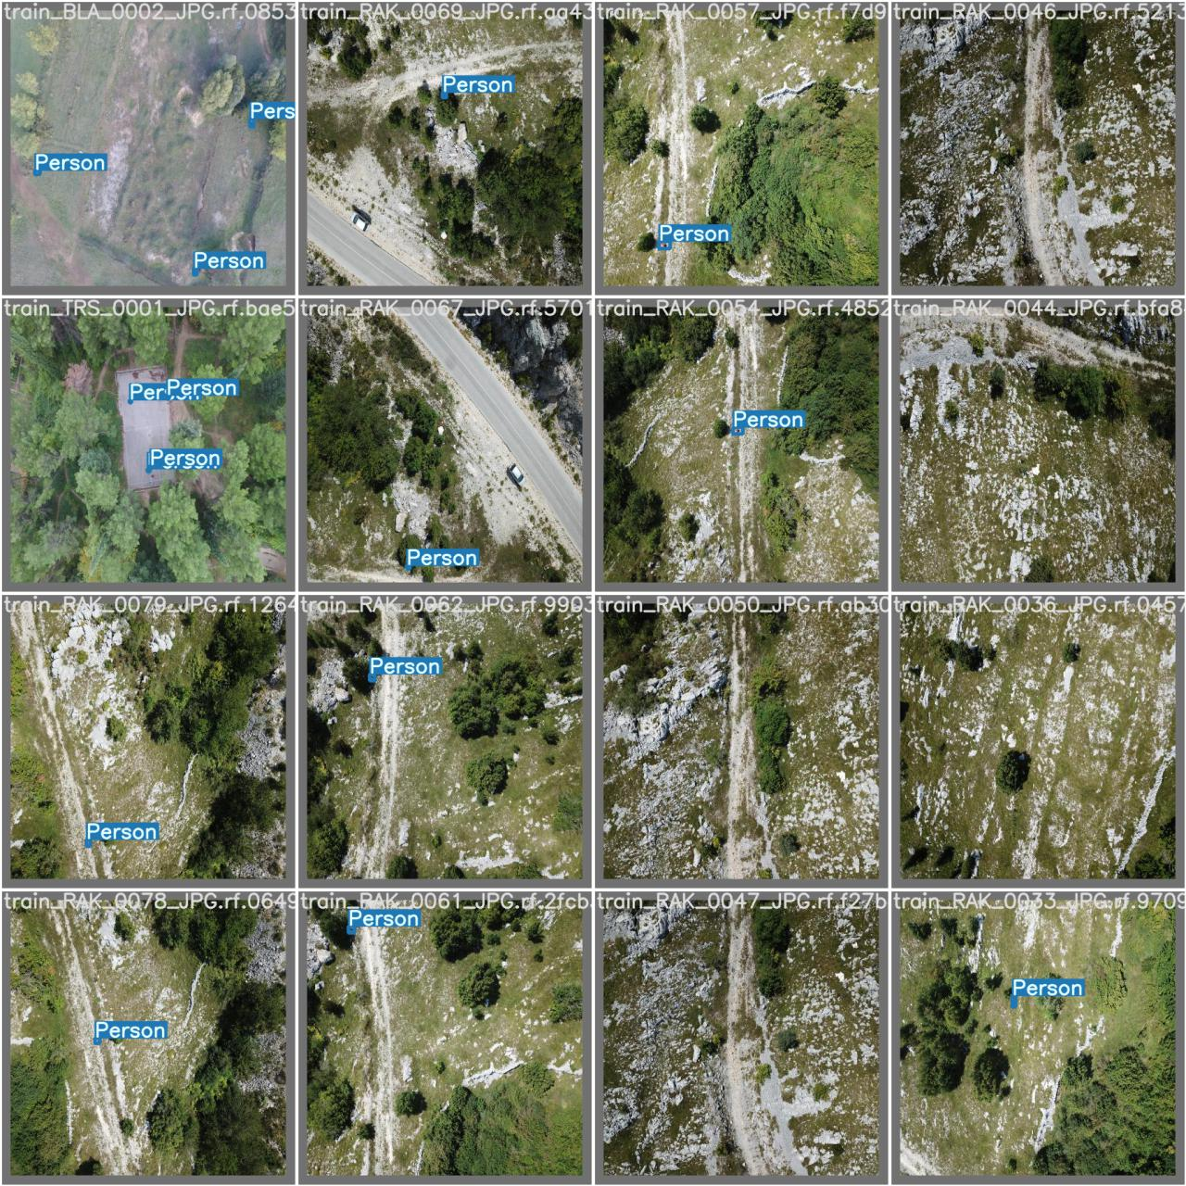
Results

Slide 16
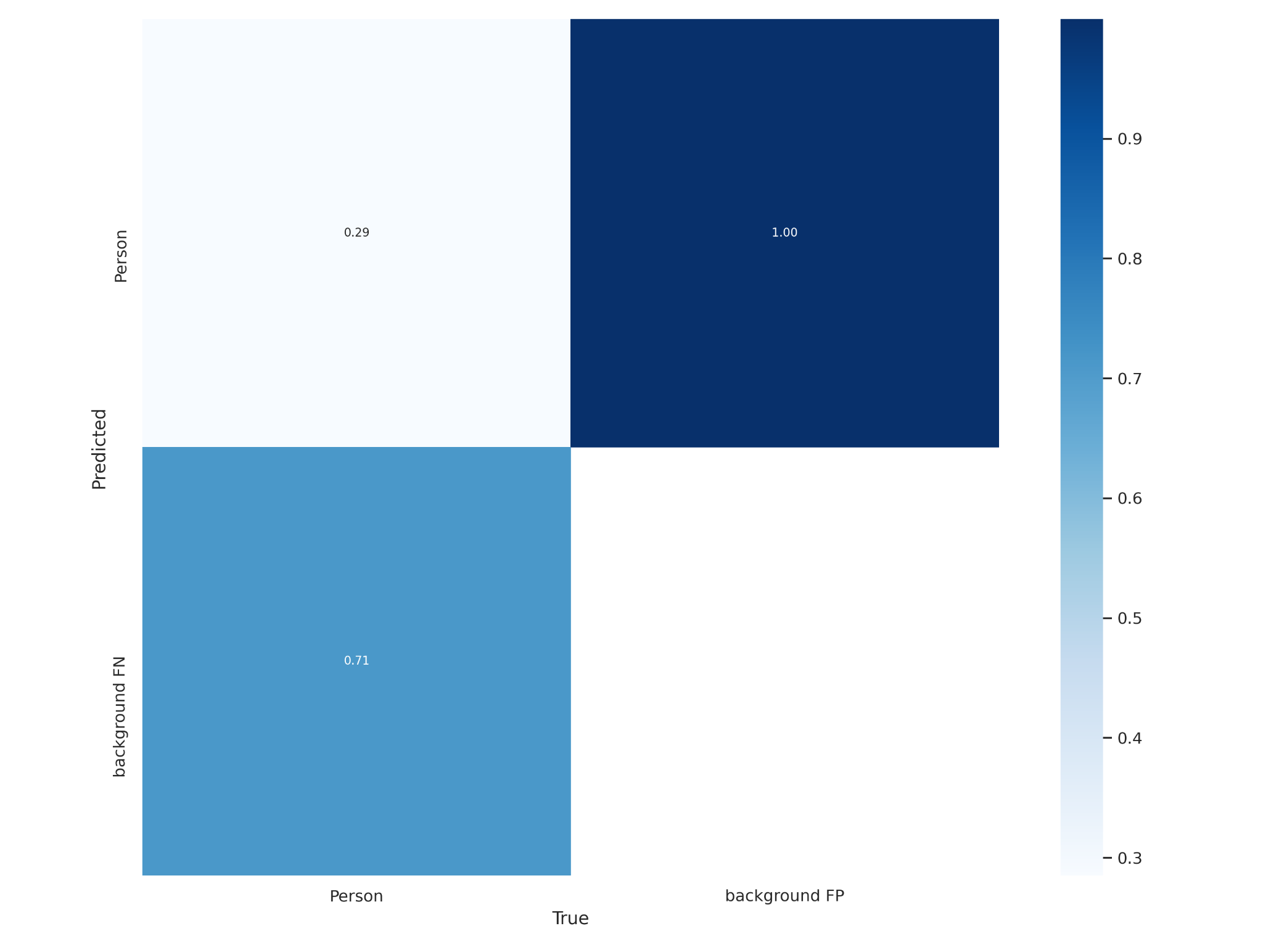
Results

Slide 17
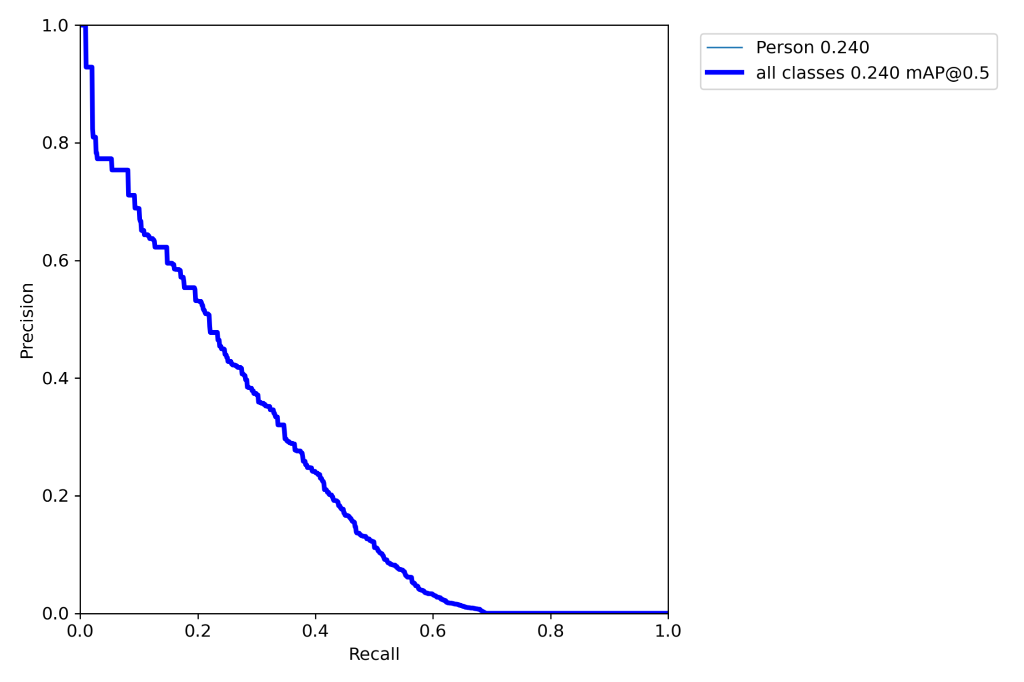
Results

Slide 18
Future Scope
Find a method to work around such large image (Eg : Dividing the image into 4 or 8 blocks) etc.
Implement state of the art methods (Eg: RetinaNET etc.) to improve Precision/Recall

Slide 19
Bibliography(1/2)
[1] Kundid Vasić, M.; Papić, V. Multimodel Deep Learning for Person Detection in Aerial Images. Electronics 2020, 9, 1459. https://doi.org/10.3390/electronics9091459
[2] 2017 ICCV] [RetinaNet] Tsung-Yi Lin, Priya Goyal, Ross Girshick, Kaiming He, Piotr Dollár
“Focal Loss for Dense Object Detection” - Link
[5] Dunja Božić-Štulić, Željko Marušić, Sven Gotovac: Deep Learning Approach on Aerial Imagery in Supporting Land Search and Rescue Missions, International Journal of Computer Vision, 2019.
[6] A. Robicquet, A. Sadeghian, A. Alahi, S. Savarese, Learning Social Etiquette: Human Trajectory Prediction In Crowded Scenes in European Conference on Computer Vision (ECCV), 2016.
[7] Okutama-Action: An Aerial View Video Dataset for Concurrent Human Action Detection. M. Barekatain, M. Martí, H. Shih, S. Murray, K. Nakayama, Y. Matsuo, and H. Prendinger. The IEEE Conference on Computer Vision and Pattern Recognition (CVPR) Workshops, 2017, pp. 28-35

Slide 20
Bibliography(2/2)
Credits for intuition and overall problem statement:
[3] Medium Blog : The intuition behind RetinaNet
[4] Medium Blog : Sampling Stanford drone dataset - Link
[8] Chenfan Sun, Wei Zhan, Jinhui She, Yangyang Zhang, “Object Detection from the Video Taken by Drone via Convolutional Neural Networks”", Mathematical Problems in Engineering, vol. 2020, Article ID 4806359, 1 page, 2020.
[9] Sambolek, Saša & Ivašić-Kos, Marina. (2020). Person Detection in Drone Imagery. 1-6. 10.23919/SpliTech49282.2020.9243737.
[10] Hung, G.L., Sahimi, M.S.B., Samma, H. et al. Faster R-CNN Deep Learning Model for Pedestrian Detection from Drone Images. SN COMPUT. SCI. 1, 116 (2020). https://doi.org/10.1007/s42979-020-00125-y

